Slide 1


Group Members:
M. Ammad Hassan (m.ammadhassan@yahoo.com)
Huraira Malik (hurairamalik2200@gmail.com)
Yasir Ali (ali.yasir343@gmail.com)
Instructor:
Muneer Khan
Presented To:
Nayab Afzal

Slide 2
Bus Travelling Website
Visit to our Website

Slide 3
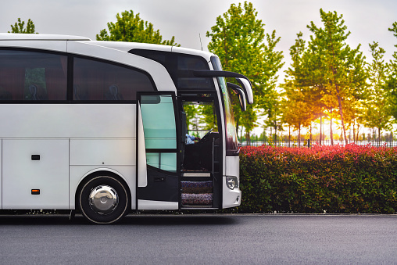
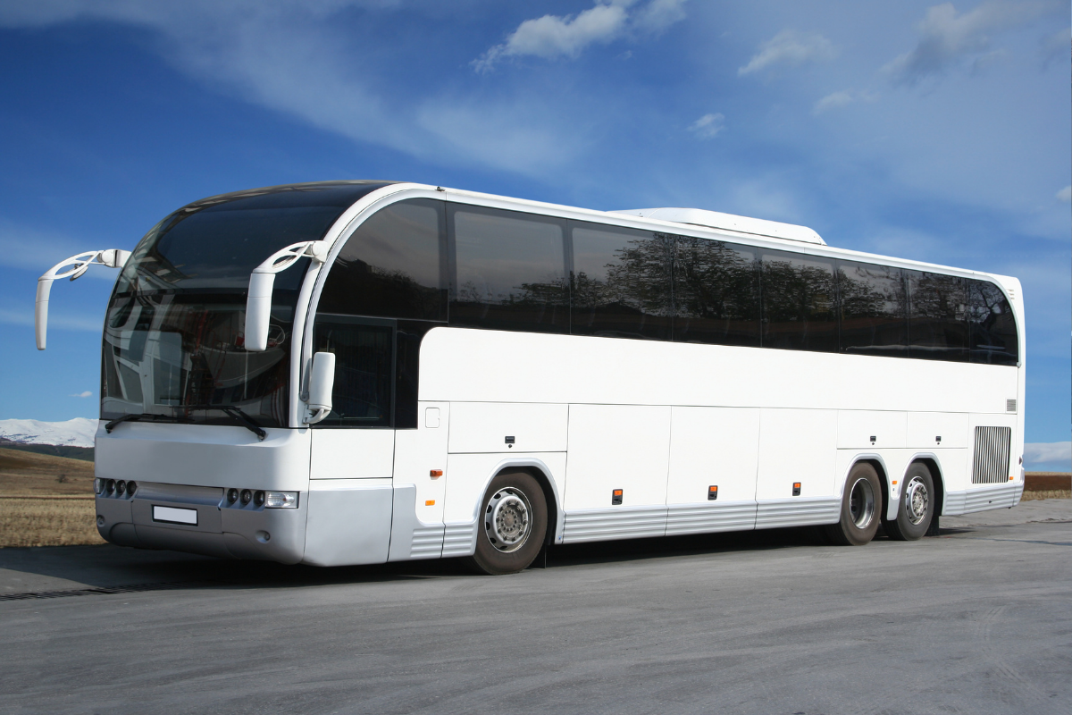
- Our Mission -
Make your travelling experience joyful and comfortable.

Slide 4
Who We Are?
H.A.Y. Travels is a bus company which gives facility with instant bookings and comprehensive choices.
H.A.Y. Travels provides highest standard of service.
H.A.Y. Travels has dedicated customer support operating 24/7.
H.A.Y. Travels is there for you, whenever and wherever.

Slide 5
Why we choose this project?
To serve the Pakistani passenger with international standard buses on minimum fares.
To facilitate the passengers with online booking of bus ticket at one tap.
To allow passengers to pay their ticket price online with flexible ways.

Slide 6




Tools

Slide 7

Languages
HTML
CSS
JS

Slide 8
Challenges
Choosing a template for travelling website.
Sharing the code instantly with group members.
Integrating different sections of website.
Adding dropdown functionality using JavaScript.
Making this website responsive.

Slide 9

We will like to ANSWER your QUESTIONS

Slide 12
Design Thinking icons

Slide 13
Big Data icons

Slide 14
Marketing Growth icons

Slide 15
Setup and Settings icons

